Slide 1
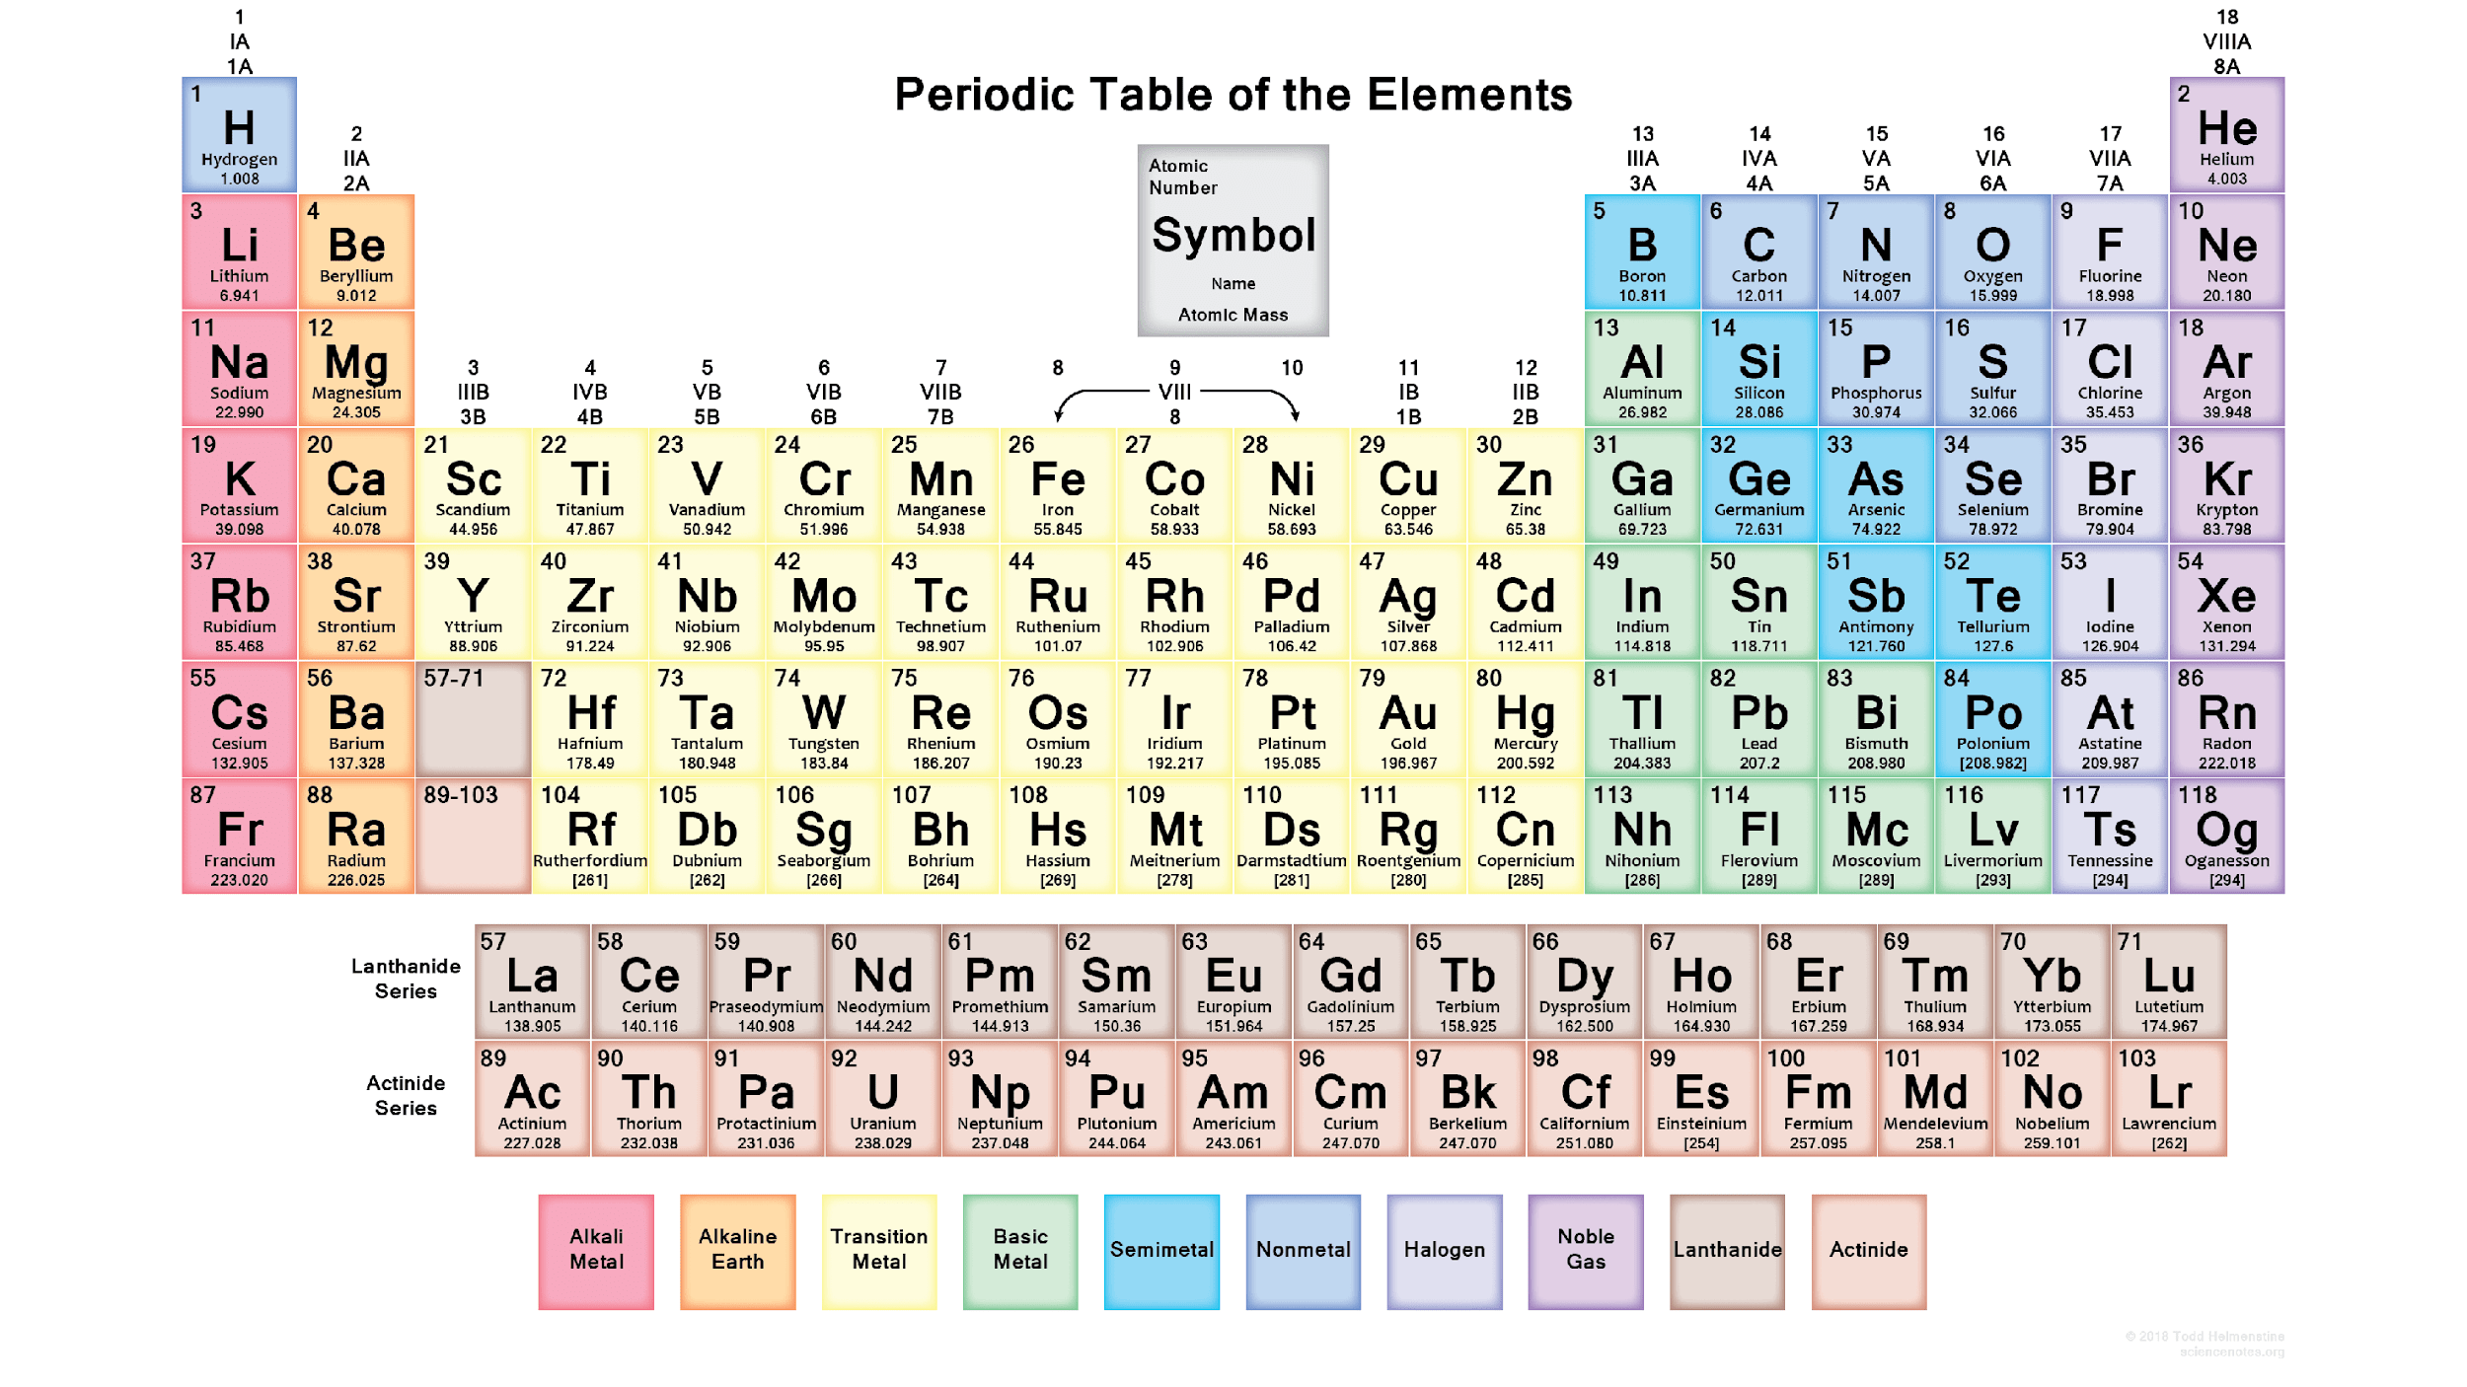
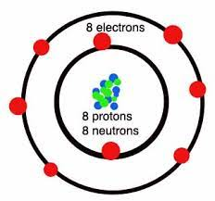
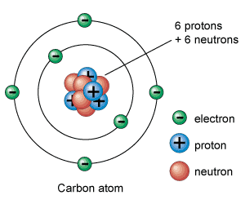
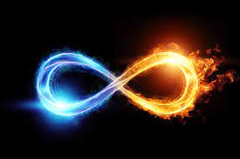
Why The Breath?
8-infinity, eternal Life
6- man was made on the 6th day. Genesis 1:23-31
Lesson Curated By:
Ej Chambers
“Ej The Yogi”
“The Prophet”
“Shu”

Slide 2
Why is Breathing SO IMPORTANT?
As Human Beings, our breathing is ESSENTIAL TO OUR EXISTENCE. *IT’S THE FIRST THING WE TAKE WHEN WE ENTER THIS BODY, AND THE LAST THING WE TAKE WHEN WE LEAVE OUT THIS PHYSICAL VESSEL*
It's SO ESSENTIAL that even before we come into the earthly atmosphere; The process of breathing starts, while we are in our MOTHER’S WOMBS.
Studies show that there is ONLY 1 CREATION that can live without OXYGEN, the Henneguya Salminicola. A parasite organism that attaches to certain species of Salmon Fish, this organism lives through the process of Anaerobic Respiration which is a process that uses electron receptors rather than molecular oxygen. Studies have also shows that this process is LESS EFFICIENT THAT AEROBIC RESPIRATION. So I ask, AS HUMANS, do we want to be MORE EFFICIENT OR LESS EFFICIENT???
IF YOU WERE NOT BREATHING, YOU WOULD NOT BE LIVING!!! THIS IS A FACT!!!

Slide 3
Anatomy of Respiratory System(Breathing)
Humans, Animals, and Plants all have a Respiratory System!!! BUT HUMANS, ANIMALS, AND PLANTS ALL HAVE A DIFFERENT BIOLOGICAL MAKEUP.
The Human Respiratory System is made up of various components, which shows TRULY how Amazing, Unique and Complex this Human Vessel is!!! (We are just going to go over the BASE PARTS of the Respiratory System)
NOSE/MOUTH. PHARYNX(throat). LARYNX(voice box). EPIGLOTTIS. TRACHEA(windpipe). AIRWAYS(bronchi & bronchioles). ALVEOLI. CAPILLARY TUBES. LUNGS AND DIAPHRAGM.

Slide 4
This is a complete picture of the human respiratory system, but as said we are going to go over the Main Known Parts.

Slide 5
We INHALE Oxygen through our NOSE OR MOUTH, when breathing through the nose the air is warmed, humidified, and filtered with little shelf-like bones in our nose called conchae. The oxygen then goes through our PHARYNX(throat), past our LARYNX(voicebox) into the TRACHEA(windpipe), all while passing the EPLIGOTTIS as well. The EPIGLOTTIS is a little “flap” located on top of our Esophagus, WHEN BREATHING this flap is down(inactive) and WHILE EATING OR DRINKING this flap becomes Active and flips up to cover our TRACHEA(windpipe). *Hence the saying from choking on food or drink “That went down the wrong pipe”… Yea it did, LITERALLY*
After the Oxygen passes the TRACHEA, it then is in the area of the lungs, entering into the BRONCHI AND THEN THE BRONCHIOLES. The BRONCHI sits right in the middle passage of the Lungs and the BRONCHIOLES spread out into the Right and left Lung. You can imagine the BRONCHI being like the Tree Stump right on top of the Ground, and the BRONCHIOLES as the roots that go into the Earth.
Once in the Bronchioles, the oxygen then is transferred into these Little Sacks on the end of them called ALVEOLI(alveolar sacs). ALVEOLI IS RESPONSIBLE FOR TAKING IN THE OXYGEN AND PUSHING OUT CARBON. At the ALEVOLI is where the Magick happens!!! There is a web-like structure around the alveoli called CAPILLARIES, OR CAPILLARY TUBES, this is where the actual gas exchange takes place- The Oxygen Atoms release from the Alveoli sacks into the Capillaries, simultaneously, while The Carbon Atoms are released from the Capillaries into the Alveoli, and once that exchange is made. EXHALE

Slide 6
All of that happens in the blink of an eye, simultaneously as you breathe throughout your day…. JUST THINK ABOUT EVERYTHING BROKEN DOWN, in simplest terms, ABOUT THE RESPIRATORY SYSTEM AND BREATHING PROCESS. WE ARE TRULY DIVINE
Just by Observing the PROCESS of breathing, we see how TRULY magickal this human body really is. This human vessel is a timeless energy machine, everything is energy-ATOMS. “We went from Atoms to Adam”. - God Zeus
From Spiritual-Physical… EVERYTHING COMES BACK TO THE BREATH. THE FACT OF THE MATTER IS- IF YOU WERE NOT BREATHING, YOU WOULD NOT BE LIVING.

Slide 7
Prana, Chi/Qi/Ki, Sekhem, Holy Spirit
In Yogic Philosophy, as well as the Hindu religion, Prana is sometimes simply translated to “breath”. Prana is seen as a universal energy which flows in currents in and around the body. In Yogic Philosophy we can advance and expand our consciousness By TAPPING IN to the Pranic Energy within us, as well as heal ourselves.
Going away from the Hindu religion and coming to the Roots of traditional Eastern(Chinese/Japanese/Asian) Culture/medicine and martial arts. We have Chi/Qi/Ki. Chi, Qi and Ki are all interchangeable with another. These all represent YOUR LIFE FORCE, the energy that flows THROUGH YOU; AND EVERYTHING AROUND YOU. The Vital Life Force that runs through all living beings. EVERYTHING THAT HAS EVER BEEN CREATED, IS SOMEWHERE ON THE SPECTRUM OF CONSCIOUSNESS, EVERYTHING HAS CHI, AND EVERYTHING IS MADE UP OF ATOMS
In Kemet(Egypt) they also were aware of this Vital, Subtle Life Force energy that is WITHIN US AND WITHIN EVERY LIVING THING. The Ancient Ancestors(sheps) had there Own Term- SEKHEM, OR ANKH. Sekhem, or Ankh, was seen as the Life Force Energy or power that exist within the Universe, Ankh(sekhem) is the Spiritual Essence and Spiritual Strength that resides within Humans, but ALL LIFE DRAWS UPON THIS ANKH FORCE… SEKHEM.

Slide 8
Prana, Chi/Qi/Ki, Sekhem, Holy Spirit
Now coming down the TimeLine in Human Civilization into Modern Day Teachings… Looking at Christianity we all, more or less, have heard the term “Holy Spirit” sometime, somewhere. The Holy Spirit is seen as The Third Component of the “Holy Trinity”. TRINITY=3. The Holy Spirit is seen to be an extension of “God” spiritually active in the world. And it is said to be within every single one of us if we “Open Our Hearts to God” and “The Great savior Jesus Christ”. It is NO COINCIDENCE AT ALL that the “Holy Spirit” is Manifested/Personified as the 3RD COMPONENT OF THE TRINITY.
The word spirit is defined as the nonphysical part of a person which is the seat of emotions and character; the soul. The ETYMOLOGY OF THE WORD SPIRIT comes from the Latin “Spirare” which means to Breathe.

Slide 9
Prana, Chi/Qi/Ki, Sekhem, Holy Spirit
WE ARE ALL SPIRITUAL BEINGS HAVING A HUMAN EXPERIENCE!!! THINGS HAPPEN SPIRITUALLY/ENERGETICALLY/ETHERICALLY BEFORE IT MANIFEST INTO A PHYSICAL REALITY.
Now How would one Connect To The Prana, Chi/Qi/Ki, Sekhem, The Holy Spirit??? Coming back to THE FACT- If we were NOT BREATHING, we WOULD NOT be alive and conscious. Wouldn’t it make sense to connect to IT ALL we simply just become aware of Our Breath?
When we Become CONSCIOUS OF OUR BREATH, WE CAN IMMEDIATELY ACTIVATE OUR THIRD EYE, WHICH THEN ALLOWS OUR THIRD EYE TO BE OPEN AND ABLE TO EXPAND OURSELVES(OUR SOULS) TO DIFFERENT DIMENSIONS OF CONSCIOUSNESS. This can allow us to become “woke” as some would say, or just simply allow us to change our mindset/perception of Life to a more Harmonious View.

Slide 10
Prana, Chi/Qi/Ki, Sekhem, Holy Spirit
Now Knowing That the word Spirit breaks down to Breath, if we truly trying to connect to the SOURCE THAT IS WITHIN- we should just connect with our breath. LET YOUR BREATH GUIDE YOU- EBB AND FLOW.
The Pineal Gland(3rd eye) is an endocrine gland located in the posterior aspect of the cranial fossa in the brain. Its importance is in the circadian cycle of sleep and wakefulness. *In spiritually there is a term people used called “woke”*… The main function of the pineal gland is to receive information about the state of the light-dark cycle from the environment and convey this information by the production and secretion of the hormone melatonin. The 3rd eye, WHICH IS REALLY OUR FIRST EYE, comes from the pineal gland's primary function of 'letting in light and darkness', just as our two eyes do.
In spirit science, The Pineal Gland is said to be “The Seat of The Soul”.

Slide 11
Prana, Chi/Qi/Ki, Sekhem, Holy Spirit
The word spirit is defined as the nonphysical part of a person which is the seat of emotions and character; the soul. The ETYMOLOGY OF THE WORD SPIRIT is Breath, or to Breathe. Our emotions are what can cause are energy to get STAGNANT, which lowers our life force and can cause Energy Restrictions within our body and also can manifest as PHYSICAL DIS-EASE within the Human Body. As Humans we also Want to Have Good Positive Character, with ourselves and others, so being negative; having bad thoughts, eating bad food, wishing evil upon others. Can lower your Life Force Energy. We are NOT perfect but we should damn sure STRIVE TO BE RIGHTEOUS(MAAT).
Becoming conscious of YOUR Breath can put you into the Realm Of what some would Call “Breath Work”. Allowing your breath to flow naturally in and out, or maybe adding some breathing techniques. LET YOUR BREATH GUIDE YOU…

Slide 12
PROPER BREATHING MECHANICS
Recent Scientific Studies Show that nearly 80% of the Human Population have some type of Breathing Dysfunction, or just Straight Up don’t breathe right. Humans have Developed POOR BREATHING MECHANICS over the years, as Most People are MOUTH BREATHERS-INSTEAD OF BREATHING THROUGH OUR NOSE.
OUR NOSE WAS MADE FOR BREATHING IN AND OUT, OUR MOUTH WAS MADE TO TALK, SING, TASTE, LICK, KISS... *just think of how many functions your nose has for everyday life, versus the Mouth, that should tell you something!!!*
Mouth Breathing can also gear our body to be In a state of “Fight-or-Flight”- which is our Sympathetic Nervous System. The Recovery, or the Healing, comes from Us RELAXING AND BEING CALM, this relates to Our Parasympathetic Nervous System- “Rest and Digest”.
Now look at the WORLD AS A WHOLE, constantly in Wars, in survival mode, in a Fight-or-Flight Frame of Mind.

Slide 13
PROPER BREATHING MECHANICS
Now when you look at a baby, WHEN THEY BREATHE- THEIR STOMACH EXPANDS ALL THE WAY OUT. THEY TAKE DEEP ABDOMINAL BREATHS… We can Learn something about this from the Little Ones, as they are Fresher out of Their Portal into this reality- The Programming or “The Matrix’ hasn’t got to em yet… THAT’S WHY IT'S GOOD TO START LIVING A POSITIVE, HEALTHY, HARMONIOUS LIFE AS YOUNG AS POSSIBLE…
The BIG expansion of the abdomen area comes from the EXPANSION OF THE DIAPHRAGM. When you look at MOST people when they breathe, their belly expands but not fully, which results in a Shortened Breath. WE DON’T WANT TO SHORT OURSELVES ON ANY LIFE FORCE ENERGY!!!
On a INHALE, your diaphragm contracts (tightens) and moves downward. This creates more space in your chest cavity, allowing the lungs to expand, when you INHALE- the diaphragm pulls down on the lungs, creating negative pressure in the chest, resulting in air flowing into your lungs. When you exhale, the opposite happens — your diaphragm relaxes and moves upward in the chest cavity.

Slide 14
PROPER BREATHING MECHANICS
Proper breathing starts in the nose and as your diaphragm expands, the belly expands and your lungs fill with air.
THE LUNGS WERE NOT MADE FOR BREATHING… Lungs maximize the area for a gaseous exchange through the presence of alveoli which are richly supplied with blood.

Slide 15
THE BENEFITS OF PROPER BREATHING MECHANICS
Diaphragmic Breathing(“abdominal breathing” or “belly breathing”) Promotes a FULL OXYGEN EXCHANGE.
DIAPHRAGMIC BREATHING ALSO SLOWS DOWN THE HEART BEAT AND CAN LOWER OR STABILIZE BLOOD PRESSURE.
*When we Rewire Ourselves to breathe Properly, A LOT IN LIFE CAN CHANGE, JUST NATURALLY- YOUR RAISING YOUR VIBRATION AND ALLOWING MORE OXYGEN INTO YOUR LUNGS-WHICH GETS MORE OXYGEN INTO YOUR BLOODSTREAM…* SELF-HEALING…*

